Slide 1

Modern Control Theory
Lecture No. 16
Understanding the Kalman Filter in a Bayesian Framework
Derivation of the Kalman Filter in a Bayesian Framework

Slide 2
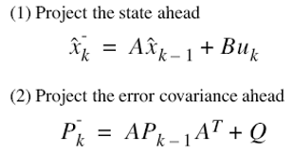



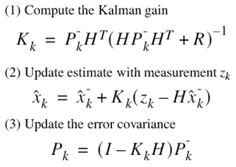
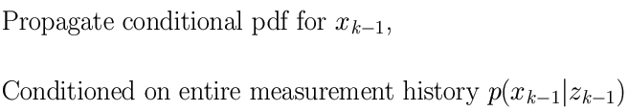
Kalman Filter --- A Bayesian Approach
Update
(k-1)+
(k)-
(k)+
Prediction
k
k-1
z(k)
z(k-1)

Slide 3
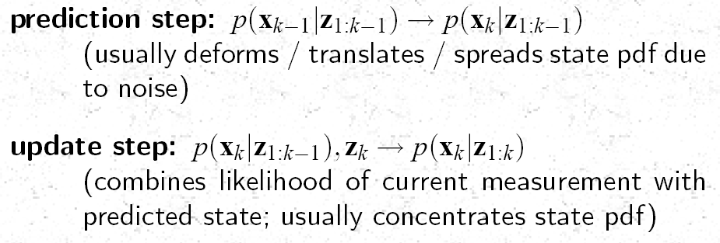
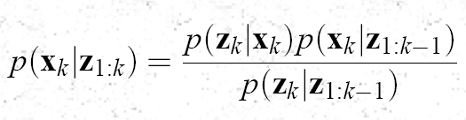
Prediction & Update

Slide 4

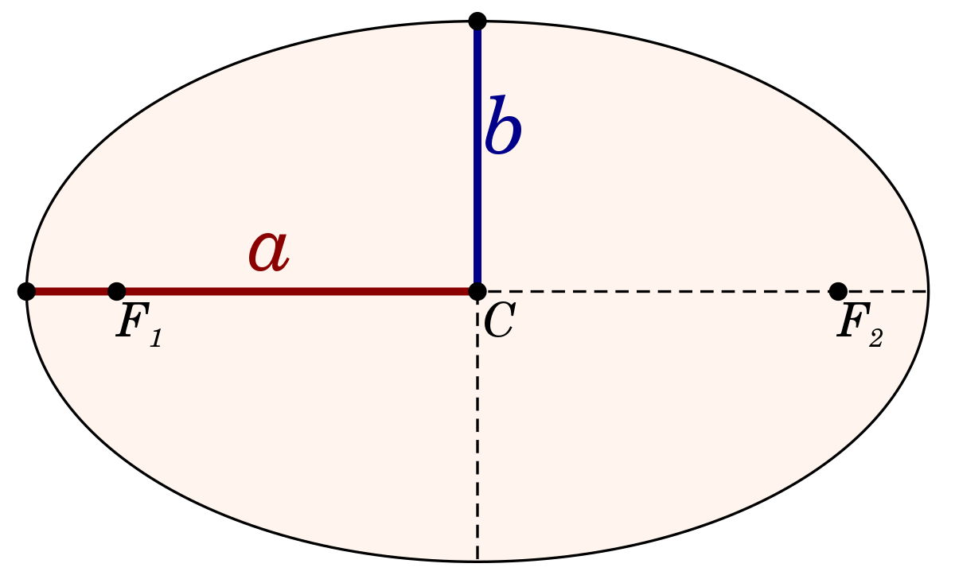


Kalman Filter --- The Bayesian Behavior
update step
(k-1)+
(k)-
(k)+
prediction step
k-1
k
z(k-1)
z(k)

Slide 5
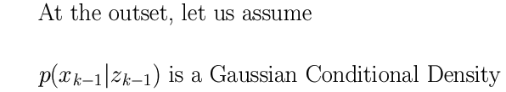
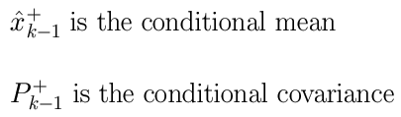
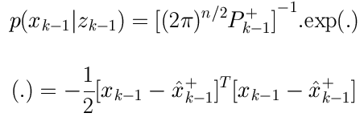
Propagating the Gaussian Density Function
Update
(k-1)+
(k)-
(k)+
Prediction
k-1
k
z(k-1)
z(k)

Slide 6
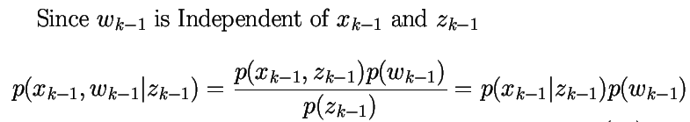
Independence of Noise Function
(k-1)+
(k)-
(k)+
Prediction
Update
k-1
k
z(k-1)
z(k)
w(k-1)
w(k)

Slide 7

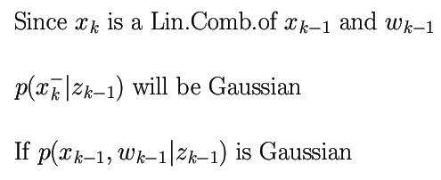


The Bayesian Framework
Update
(k-1)+
(k)-
(k)+
Prediction
k-1
k
z(k-1)
z(k)

Slide 8







Computing the Mean & Covariance of the Prob. Density Function
Update
(k-1)+
(k)-
(k)+
Prediction
k-1
k
z(k-1)
z(k)

